Slide 1




Slide 2
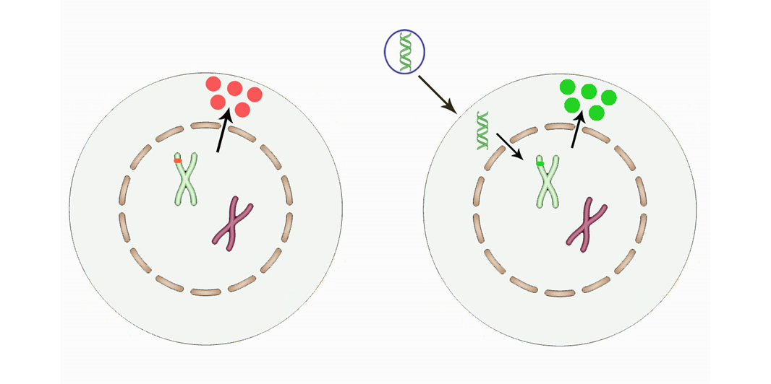
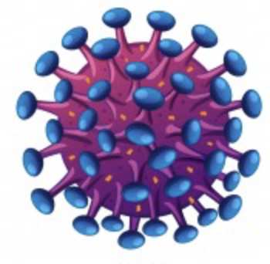
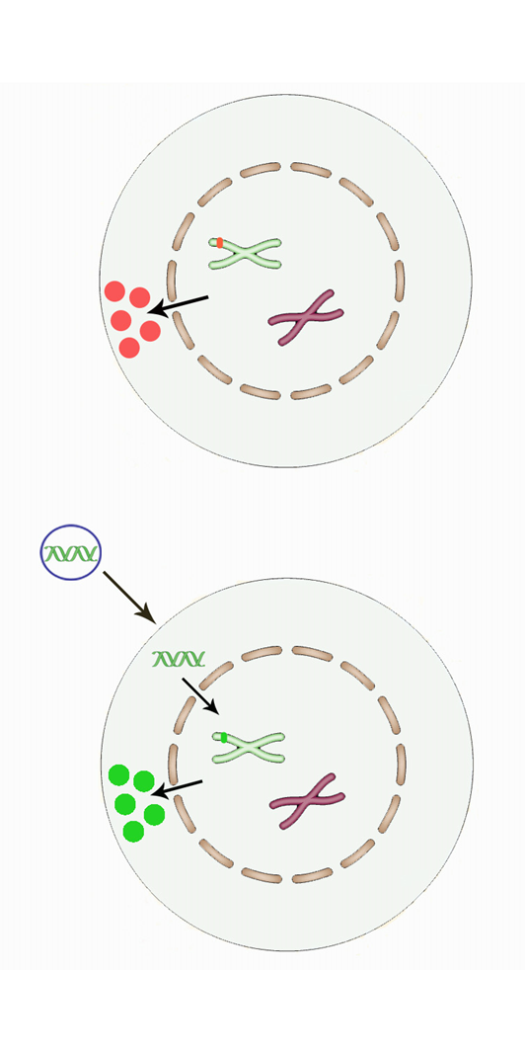
Gene Transfer vs. Targeted Genome Editing
Diseased cell
Therapeutic protein
Viral
vector
Gene replacement by viral-derived vectors
Permanent (RV/LV) or long-term stable (AAV) modification of the cell
Effective & safe in several disease conditions
Risks of genotoxicity, unregulated transgene expression, vector immunogenicity

Slide 3
Gene Transfer vs. Targeted Genome Editing
Diseased cell
Therapeutic protein
AN-induced
DNA DSB
Viral
vector
Exogenous template
Gene replacement by viral-derived vectors
Targeted gene correction with Artificial Nucleases (AN)

Slide 4
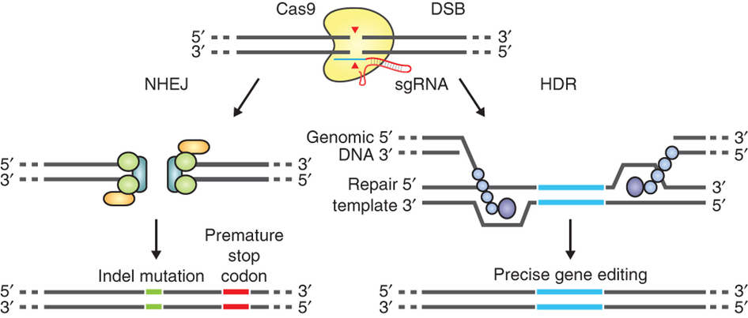
Targeted Genome Editing
DSB : Double Strand Break
Non Homologous End Joining : NHEJ
HDR : Homology Directed Repair
Genomic
Genomic
Exogenous
template
Gene correction/targeted integration
Gene knock-out
Adapted from Ann Ran et al., Nat Prot 2013

Slide 5
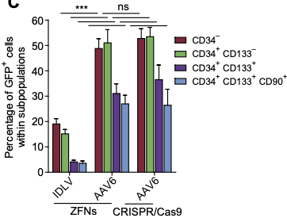
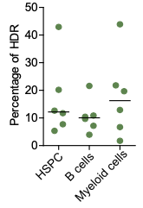

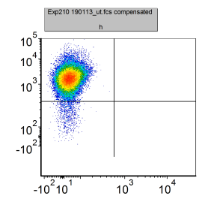
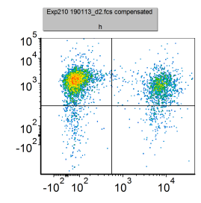
Gene Editing: “One Strategy to Fix Them All”
Exogenous template
CD34+ cells from Bone Marrow or Cord Blood
(also from of a SCID-X1 patients)
IL2RG-cDNA
PGK
GFP
AN Target
Site
Xenotransplantation into NSG mice
In vitro cell culture analysis
IL2RG locus (X Chr.)
4
5
6
Exon
→ IL2RG mutations cause SCID-X1
→ Lack of T and NK cells, impaired B cells
Transcript from the endogenous promoter
Targeted integration
4
IL2RG-cDNA
PGK
GFP
6
SD
SA
polyA
Untreated
AN + template
Long-term
multilineage
reconstitution
T cells from a healty male donor
98%
64%
27%
γ-chain
2%
5%
4%
GFP
Genovese et al., Nature 2014
Schiroli et al., Sci Transl Med 2017
Lombardo et al., Nat Biotech 2007; Lombardo et al., Nat Meth 2011

Slide 6
Gene Transfer vs. Targeted Genome Editing
Diseased cell
Therapeutic protein
AN-induced
DNA DSB
Viral
vector
Exogenous template
Gene replacement by viral-derived vectors
Targeted gene correction with Artificial Nucleases (AN)
Reconstitute the gene & its physiological expression levels
Overcome the risk of random vector insertion
Improve efficiency / yield of edited cells & characterize specificity/immunogenicity

Slide 7
Expanding the Breadth of Targeted Genome Editing
Diseased cell
Therapeutic protein
AN-induced
DNA DSB
Viral
vector
Exogenous template
Gene replacement by viral-derived vectors
Targeted gene correction with Artificial Nucleases (AN)
Reconstitute the gene & its physiological expression levels
Overcome the risk of random vector insertion
Exploit gene editing to confer novel biological properties to the cells

Slide 8
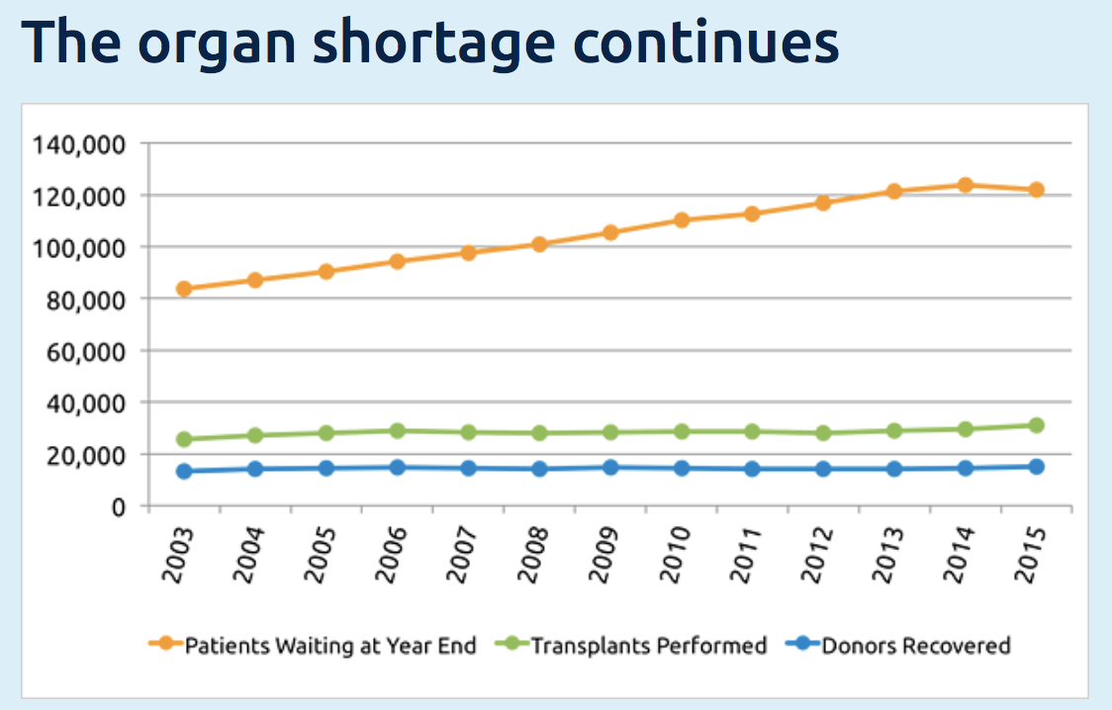


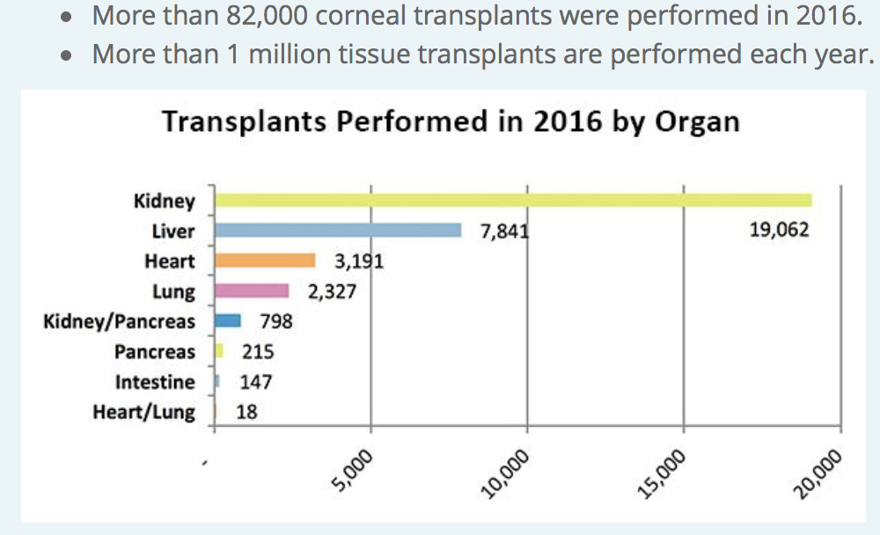
Tissue & Organ Transplantation
Paucity of donors (HLA-matching)

Slide 9
Generation of Universal Donor Cells
Untreated Cells
CTL-mediated rejection of
allogeneic tissue/organ
98%
Clinical-grade iPSC cell line
B2M
AAAA
TCR
HLA-ABC
Recipient CTL
B2M
HLA-ABC
Allo - HLA
Antigen
MHC-I
B2M
Donor cell

Slide 10
Generation of Universal Donor Cells
Untreated Cells
CTL-mediated rejection of
allogeneic tissue/organ
98%
Clinical-grade iPSC cell line
B2M
AAAA
HLA-ABC
UT
B2M^{-/-}
Recipient CTL
B2M
B2M Disrupted Cells
Allo - HLA
% of killing
Recipient NK cell
100%
Donor cell
CD8+
NK

Slide 11
Generation of Universal Donor Cells
B2M–mediated expression of
a single chain HLA-E trimer linked to TK
No sgRNA
Cas9 + sgRNA
98%
73%
AAAA
B2M
B2M
pep
HLA-E*
IRES
TK
pA
+/- HLA-G (long or soluble)
Recipient
NK cell
19%
8%
HLA-ABC
HLA-E*
2.5
HLA-E/G
HLA-E* trimer
2
Antigen
UT
1.5
B2M^{-/-}
MHC-I
Fold killing
B2M
1
B2M^{-/-}/HLA-E⁺
Donor cell
0.5
Crew et al., Mol Imm 2005; Le Maoult et al., FASEB 2013; Zhao et al., SCR 2014;
Gornalusse et al., Nat Biot 2017
0
CD8+
NK

Slide 12


Slide 13
Therapeutic Gene Silencing
The scope of gene therapy goes beyond gene replacement → gene silencing
Diseases caused by dominant-negative/gain-of-function mutations & repeat expansion disorders:
Hypercholesterolemia
Spinocerebellar ataxia type 1 (SCA1) …
Infectious diseases:
HBV
HIV
Others:
Hemoglobinopathies
To silence gene expression:
RNA interference (si/shRNA)
- Stable expression/delivery of the RNAi molecules
Gene inactivation (Artificial Nucleases / Base Editors)
- For AN, induction of the DNA Damage Response (DDR)
Targeted epigenetic silencing

Slide 14
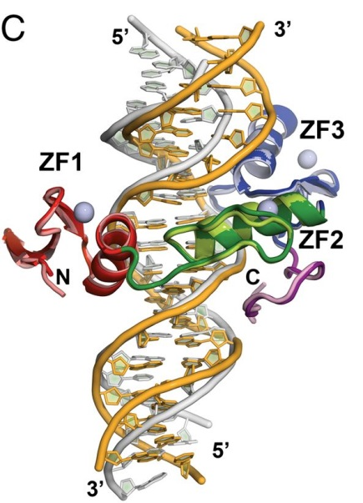
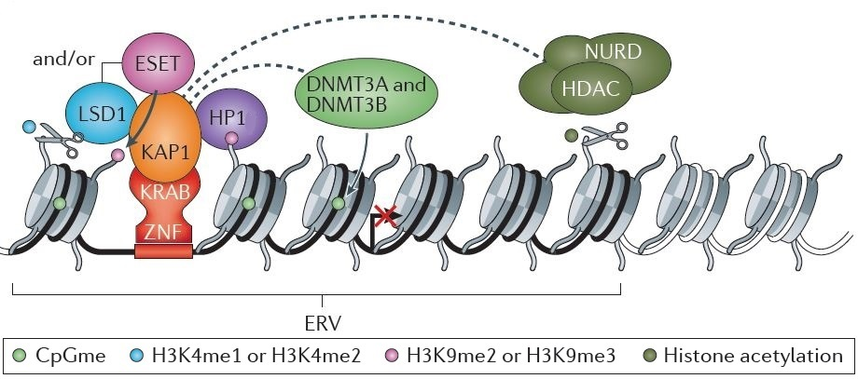
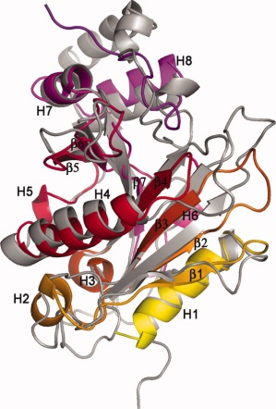


Epi-editing: Background
Permanent epigenetic silencing of Endogenous Retroviruses (ERV)
Engineered Transcriptional Repressors
DNMT3L
Custom-made DNA Binding Domain
i.e. ZFP / TALE / dCas9
From Feschotte et al., Nat Rev Genet. 2012
Effector Domain
from a naturally occurring transcriptional repressor
Targeting by KRAB-ZFPs → Initiator
Recruitment of an epigenetic repressive complex
De novo DNA methylation (DNMT3A) → Final locker
Selected domains: KRAB, DNMT3A & DNMT3L

Slide 15
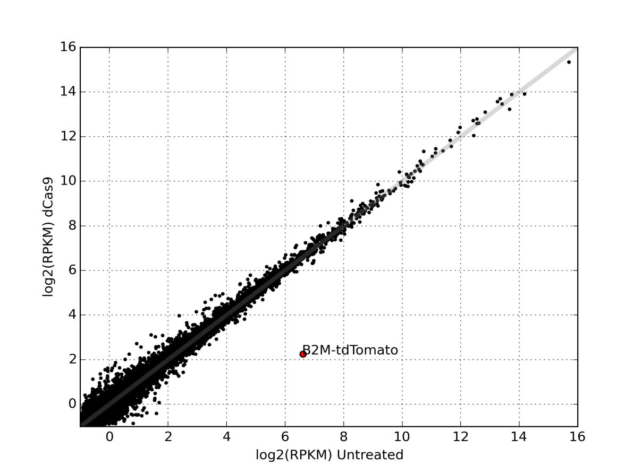
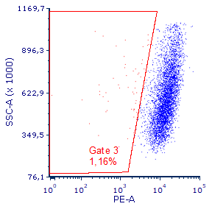
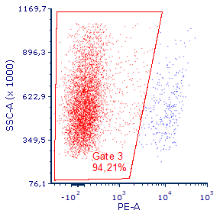

Epi-editing: Efficiency & Mode of Action
Transient expression of the ETRs
250K
ETR:K/D3A/D3L
ETR
200K
Flow
cytometry
80%
150K
e.g. B2M gene
100K
CpG island
Human or mouse
cells
50K
0
SSC-A
0
10²
10³
10⁴
10⁵
PCSK9 gene
GOF mutations cause Familial Hypercholesterolemia
LOF mutations protect from Coronary Heart Diseases
B2M
ETR:K
ETR:D3A
ETR:D3L
DNA methylation
Specificity
100
ETR:K + ETR:D3A + ETR:D3L
Mock-treated vs dCas9
80
60
Untretated
ETR-treated
% of silenced cells
% of DNA methylation
40
20
40
60
80
100
0
20
Untr.
Silenced
0
B2M:tdTomato
SSC
0
10
20
30
40
50
1.2%
94%
Days after transfection
PCSK9

Slide 16
Targeted Epigenetic Silencing: Summary
Antigen
Embryonic stem cell-derived
effector domains
(KRAB, DNMT3A & 3L)
α-chain
MHC-I
B2M
Repurposed the ERV’s silencing machinery
Programmable & targeted (ETRs)
Combinatorial (embryonic-restricted complex)
Inheritable by DNA methylation
Transient ETR delivery (hit-and-run)
Amenable to multiplexing
Effective against multi-copy genes
Resistant to external stimuli
No activation of the DDR
Potentially reversible by pharma. treatments
D3L
Active gene
( = H3K4me3, RNAP II)
Engineered Transcriptional
Repressors (ETRs)
B2M
D3A
K
Hit-and-run ETRs co-delivery
Custom-made
DNA binding domains
(TALE, dCas9)
Repressed gene
( = H3K9me3, meCpG)
B2M
B2M
MHC-I null cell
Inheritable epigenetic silencing in somatic cells
Amabile et al., Cell 2016
Relieved by forced DNA
demethylation
(5-Aza, dCas9:TET1)
Resistant to transcriptional activators
(IFN-γ, dCas9:VP160/p300)

Slide 17
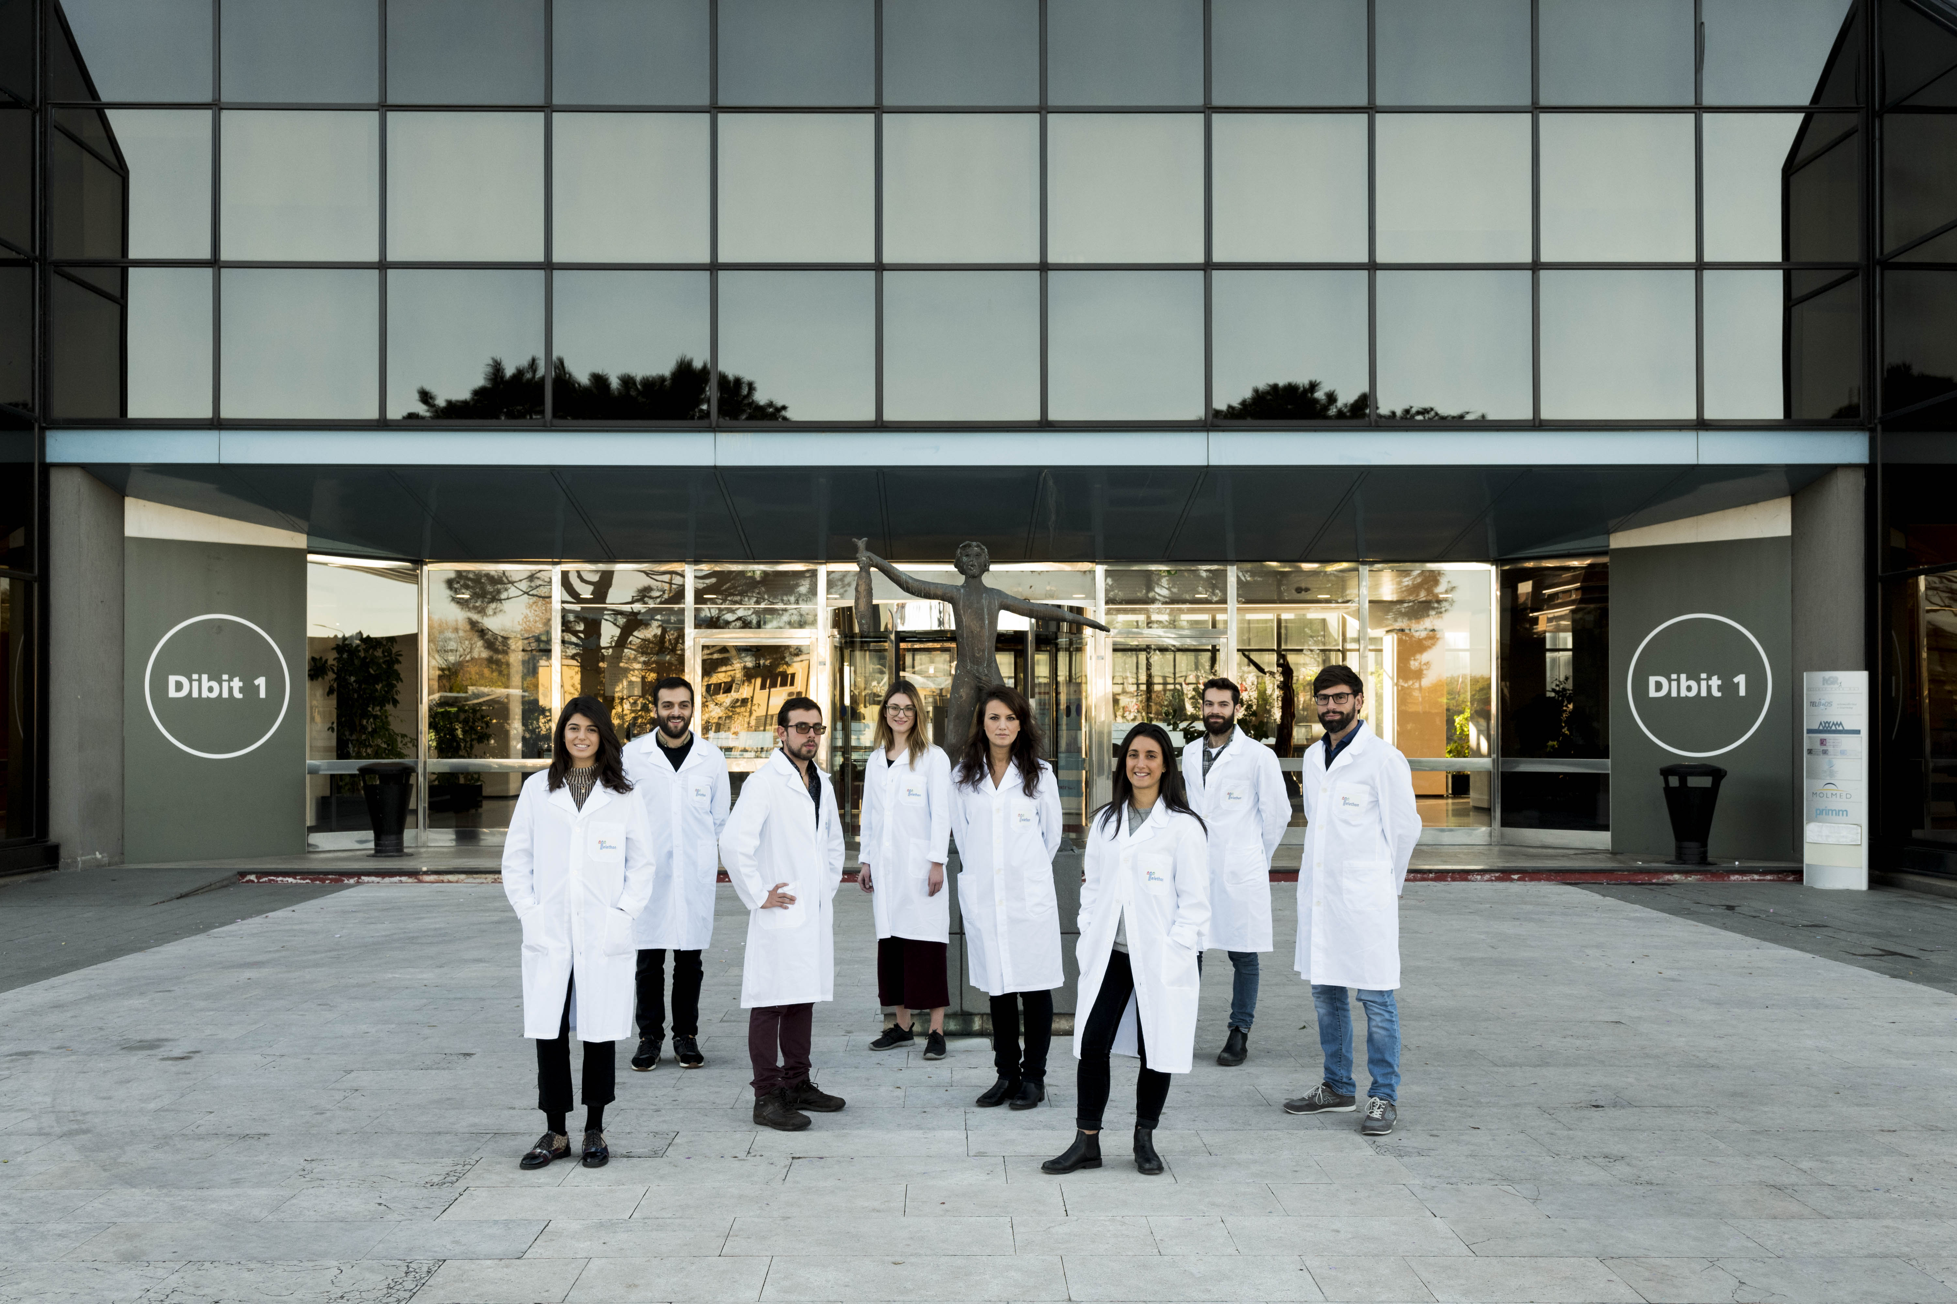




Acknowledgments
L. Piemonti
V. Sordi
R. Chimenti
S. Pellegrini
P. Monti
L. Naldini
P. Genovese
E. Montini
A. Calabria
G. Spinozzi
F. Benedicenti
Tania
Baccega
Angelo
Amabile
Alfredo
Cappelluti
Paola
Capasso
Rachele
Del Borello
Alessandro Migliara
Ilaria Caserta

Slide 19
Enhancing Gene Editing in Human T cells
Screening performed in an ad hoc developed HDR/NHEJ reporter cell line
~ 30 also active on T cells
Low Dose Donor
High Dose Donor
Mono vs Biallelic
Cas9 cutting site
FC:2.5X
FC: 1.3X
Ratio:0.5
B2M gene
1
2
3
0.5 Kb
Untreated
PGK
A
GFP
FC: 2.2X
Targeting
Biallelic HDR
Ratio:1,2
FC relative to UT
Drug-treated
GFP
SSC-A
Drugs
Vehicle
Drugs
Vehicle
B2M
B2M
N=3
N=3

Slide 20
Epi-editing: Resistant to External Stimuli & Reversible
Silenced cells
Flow cytometry analysis of cell treated as indicated
250K
250K
200K
7%
200K
150K
96%
150K
100K
100K
Untreated cells
B2M-silenced cells
4X
50K
50K
100
100
0
0
0
10²
10³
10⁴
10⁵
0
Mock
Mock
SSC
10²
10³
10⁴
10⁵
80
IFN-γ
80
IFN-γ
Targeted DNA
demethylation by dCas9-TET1
B2M
5-Azaciytidine
60
60
40
40
20
20
250K
250K
200K
200K
94%
0
0
% of max
0
10²
10³
10⁴
10⁵
0
10²
10³
10⁴
10⁵
150K
45%
150K
B2M
100K
100K
50K
50K
0
0
0
0
10²
10³
10⁴
10⁵
10²
10³
10⁴
10⁵

Slide 21
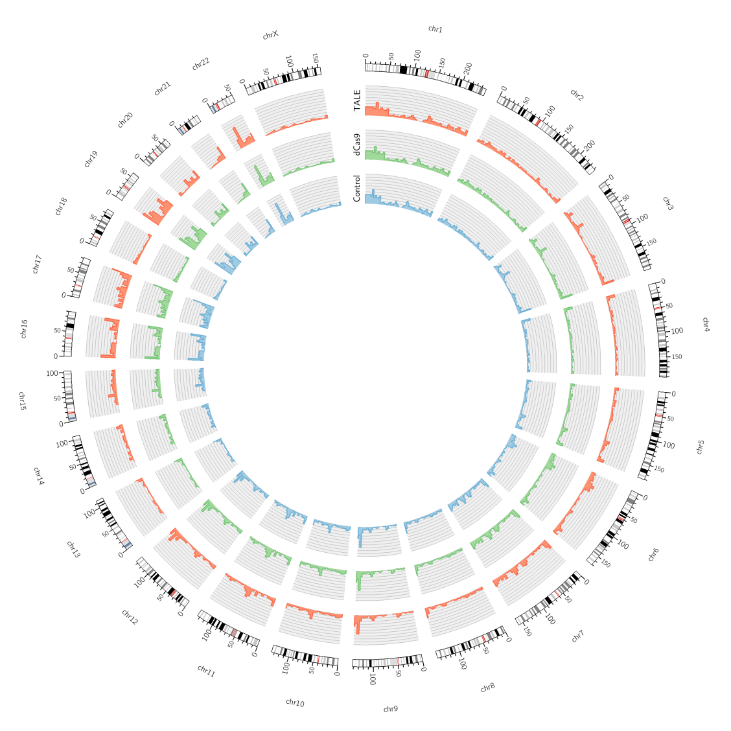
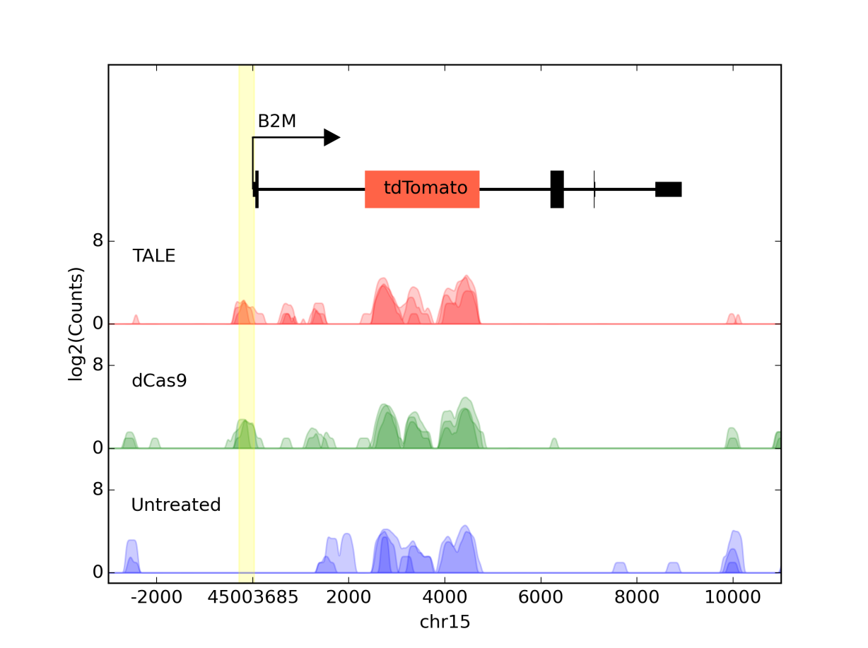
Epi-editing: Specificity
Genome-wide DNA methylation analysis
Transcriptomic analysis
Mock-treated vs dCas9
TALE
dCas9
B2M:tdTomato
Untreated

Slide 22
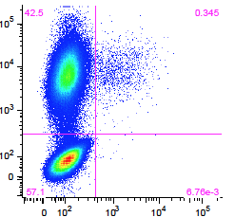
Experimental Layout: Inheritance
B2M
Genome-scale or focused
CRISPR LV libraries
REPORTER
CGI
0.5 Kb
Clonal derivate with
a drug-inducible Cas9
B2M silenced cells
Ex. 1
K
D3L
D3A
INDUCTION
INHERITANCE
100
80
0.35%
tdTomato enrichment
60
% of B2M negative cells
NGS analysis
40
20
Identification of a gene(s)
crucial for silencing maintenance
Triple ETR combination
0
0
20
40
50
LV library
Days after transfection
tdTom.

